Slide 1

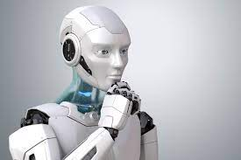

Progress this week:
Future Goals:
-Send in my system to CELS
-Make it fully compatible and easily interpreted from those unfamiliar with python and other systems
-Begin working with Urx to help Doga and Alex communicate with the UR bot
-Learned how to use anaconda and Github
-Left replit for VS code
-Completed proposal system in GitHub w/ Casey
-Completed last course in python 2
-Learned how to set up an environment for Windows
Challenges I faced:
Multiple printing errors on Makerbot print(found out my model wont work)
Explaining my coding process to those unfamiliar in the area
-Compatibility with using Windows(command line limitations and low performance)

